Slide 1

Delta Hotel
Project Semester II
Year 1
www.DeltaHotel.com
Delta Hotel

Slide 2
Approved Teacher
Delta Hotel
Teacher : Tran Thi Hong An
  Teacher of Can Tho University (CUSC)

Slide 3
Group Designer
Delta Hotel
Group Four Members
Group Leader : Le Hoai Thuong (CP200701-F04)
Member : Tran The Khai (CP200703-M17)
Member : Phan Thi Thuy Trang (CP200801-M06)
  Project Name: DeltaHotel.
  Duration Working: (08/9/2008) to (08/11/2008)

Slide 4
Contents
Delta Hotel
1.
Introduction About Group
2.
Problem Definition
3.
Process Design Document
4.
CRS/Customer Acceptance Criteria

Slide 5
Contents(Cont)
Delta Hotel
5.
Project plan
6.
GUI Standards Document
7.
Interface Design Document
8.
Flow of The Application

Slide 6
Contents(Cont)
Delta Hotel
9.
E-R Diagram
10.
Database Design Table
11.
Algorithms
12.
Coding Standards Document

Slide 7
Contents(Cont)
Delta Hotel
13.
Task Sheet
14.
Testing Document
15.
Project Review
16.
Final Check List

Slide 8
Tran The Khai (CP200703-M17)
Delta Hotel
1
Form 1: Problem Definition
2
Form 6: Table Design
3
3
Form 6: E R Diagram
4
4
Flow of The Application

Slide 9
Tran The Khai (CP200703-M17)(Cont)
Delta Hotel
5
Food & Buffet Algorithms
6
Booking Buffet Algorithms
3
7
Buffet Order Algorithms
3
8
Bill Buffet Algorithms

Slide 10
Problem Definition
Delta Hotel
Can Tho DeltaHotel Resort has some problem with the system:
  It’s too slow to know free room.
  Cost a lot of time check bill.
  Cost a lot of papers to save imformation of guest check in and check out.
An automated system is necessary to solve above difficulties.
  A consistency database.
  Daily report about guest information.
  Automatic check free room.
  Automatic calculate money for room and other services.

Slide 11
Table Design
Delta Hotel
Name of the Table | Name of Fields | Type of Fields | Type Size | Constraints | Description
Login | Password | varchar | 50 | Primary Key | Content information of user and Administration
 | UserName | varchar | 50 | Not Null
 | FullName | varchar | 50 | Allow Null
 | Address | varchar | 20 | Allow Null
 | Phone | varchar | 20 | Allow Null
 | Permission | bit | 1 | Not null

Slide 12
Table Design(Cont)
Delta Hotel
Name of the Table | Name of Fields | Type of Fields | Type Size | Constraints | Description
Room | Room_ID | varchar | 10 | Primary Key | Content information of rooms
 | Room_TypeID | varchar | 10 | Foreign key
 | Name_Room | varchar | 20 | Allow null
 | Price | money | 8 | Allow null
 | Description | nvarchar | 500 | Allow null
 | No_fo_bed | int | 4 | Not null
 | Room_Status | bit | 1 | Not null

Slide 13
Table Design(Cont)
Delta Hotel
Name of the Table | Name of Fields | Type of Fields | Type Size | Constraints | Description
RoomType | Room_TypeID | Varchar | 10 | Primary Key | Content Type of room
 | Room_type_Name | Varchar | 20 | Not null
Foods | Food_ID | int | 4 | Primary Key | Content name of foods, country, type of foods
 | Name_Food | nvarchar | 50 | Allow null
 | Country_Food | varchar | 50 | Allow null
 | Type_Food | varchar | 50 | Allow null
 | Kind_Food | varchar | 50 | Allow null

Slide 14
Table Design(Cont)
Delta Hotel
Name of the Table | Name of Fields | Type of Fields | Type Size | Constraints | Description
Customer | Customer_ID | bigint | 8 | Primary Key | Content information of customers
 | Customer_Name | varchar | 50 | Not null
 | Customer_Address | varchar | 50 | Allow null
 | Customer_Phone | varchar | 50 | Allow null
 | Customer_Gender | bit | 1 | Allow null
 | Date_of_Birth | varchar | 50 | Allow null
 | Customer_Passpor | bigint | 8 | Allow null

Slide 15
Table Design(Cont)
Delta Hotel
Name of the Table | Name of Fields | Type of Fields | Type Size | Constraints | Description
Buffet | Buffet_ID | int | 4 | Primary Key | Content information of buffets
 | Type_Buffet | varchar | 50 | Allow null
 | Status | char | 10 | Allow null
 | Price | money | 8 | Not null
 | Buffet_Date | datetime | 8 | Not null
BufferDetails | Buffet_ID | int | 4 | Primary Key | Content Food ID & Buffet ID
 | Food_ID | int | 4 | Allow null

Slide 16
Table Design(Cont)
Delta Hotel
Name of the Table | Name of Fields | Type of Fields | Type Size | Constraints | Description
Booking_ Details | Booking_ID | Bigint | 8 | Foreign key | Content information about booking room
 | Checkin_Date | datetime | 8 | Not null
 | Chechout_Date | datetime | 8 | Not null
 | Room_ID | varchar | 10 | Foreign key
Booking_ Rooms | Booking_ID | bigint | 8 | Primary Key | Content about date booking room
 | Customer_ID | bigint | 8 | Foreign key
 | Booking_Date | datetime | 8 | Allow null

Slide 17
Table Design(Cont)
Delta Hotel
Name of the Table | Name of Fields | Type of Fields | Type Size | Constraints | Description
Booking_ Buffet | BB_ID | int | 4 | Primary Key | Content information of booking buffets.
 | Buffet_ID | int | 4 | Foreign key
 | Customer_ID | bigint | 8 | Foreign key
 | Eating_date | datetime | 8 | Not null
 | BB_Date | datetime | 8 | Not null
 | Payment | char | 50 | Not null
 | Amount | int | 4 | Not null

Slide 18
Table Design(Cont)
Delta Hotel
Name of the Table | Name of Fields | Type of Fields | Type Size | Constraints | Description
BillFoods | BillBuffet_ID | bigint | 8 | Primary Key | Content information of check bills.
 | BB_ID | int | 4 | Not null
 | Total_Pay | money | 8 | Not null
 | Bill_Date | datetime | 8 | Not null

Slide 19
Table Design(Cont)
Delta Hotel
Name of the Table | Name of Fields | Type of Fields | Type Size | Constraints | Description
Bill_Rooms | Bill_Rooms | bigint | 8 | Primary Key | Content the information of check bill room
 | Booking_ID | bigint | 8 | Allow null
 | Bil_Dates | datetime | 8 | Allow null
 | Room_ID | varchar | 10 | Allow null
 | Room_Type | varchar | 20 | Allow null
 | Price | money | 8 | Allow null
 | Checkin_Date | datetime | 8 | Allow null
 | Chechout_Date | datetime | 8 | Allow null
 | Total_Pay | money | 8 | Allow null

Slide 20
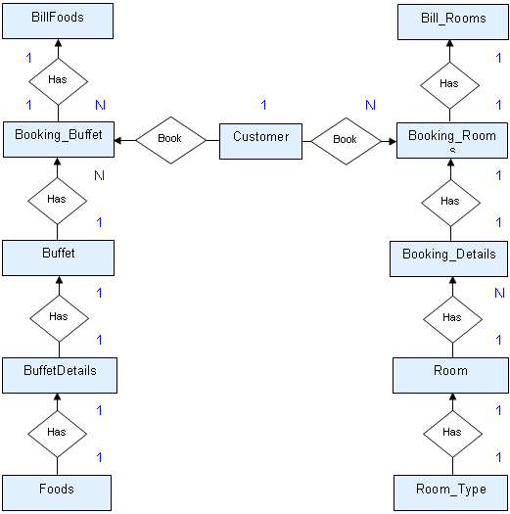
ER Diagram
Delta Hotel

Slide 21
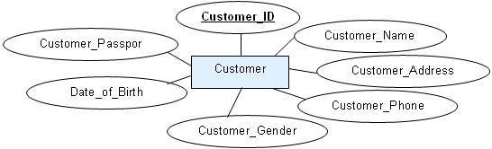
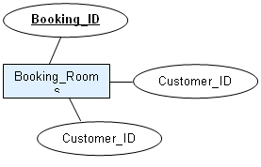
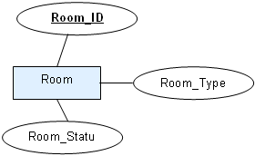
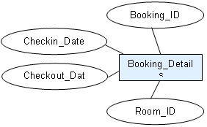
ER Diagram(Cont)
Delta Hotel

Slide 22
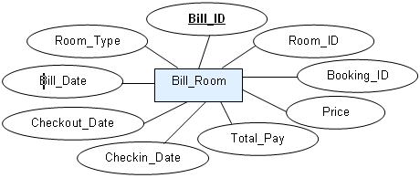
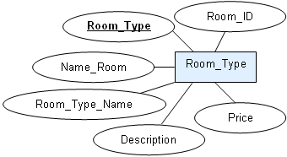
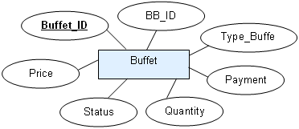
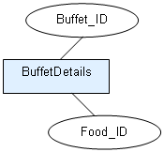
ER Diagram(Cont)
Delta Hotel

Slide 23
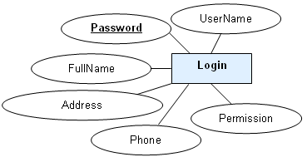
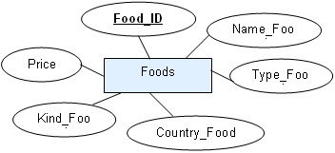
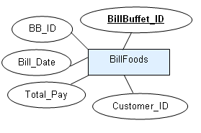
ER Diagram(Cont)
Delta Hotel

Slide 24
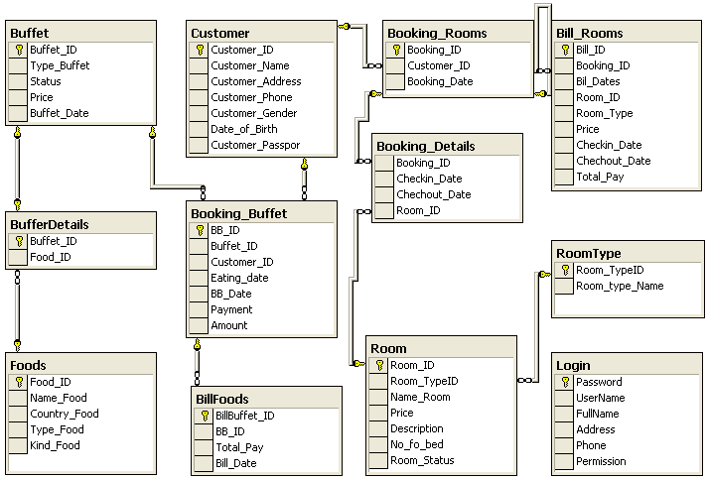
ER Diagram(Cont)
Delta Hotel

Slide 25
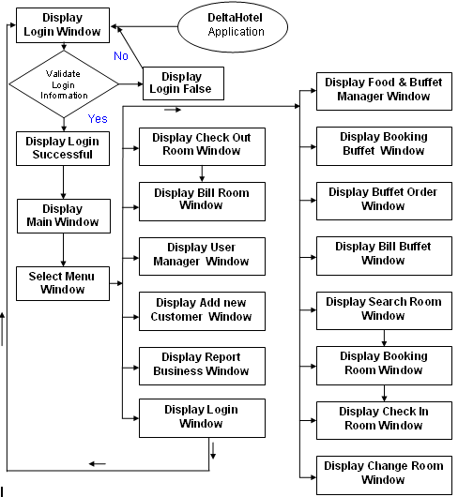
Flow of The Application
Delta Hotel

Slide 26
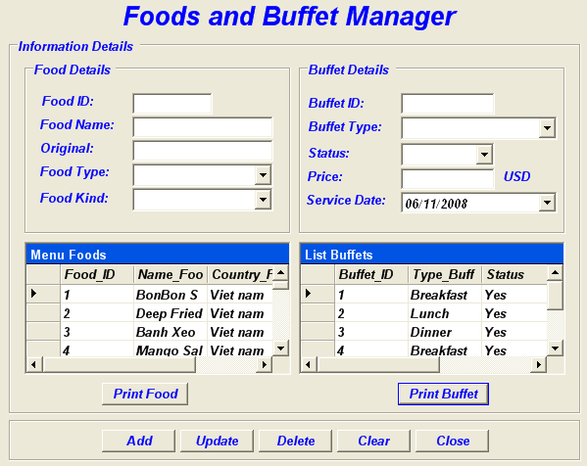
Food & Buffet Form
Delta Hotel

Slide 27
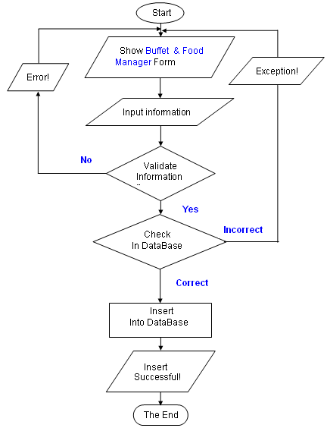
Add Food & Buffet Algorithms
Delta Hotel

Slide 28
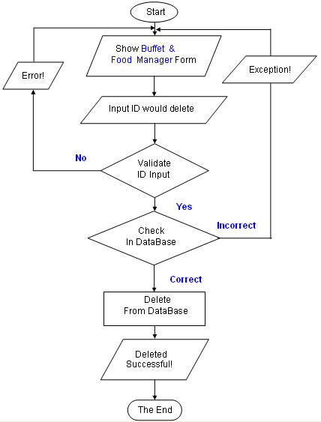
Delete Food & Buffet Algorithms(Cont)
Delta Hotel

Slide 29
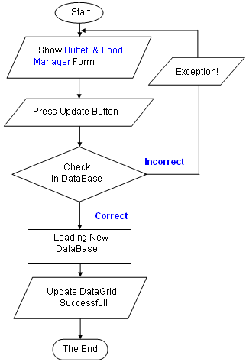
Update Food & Buffet Algorithms(Cont)
Delta Hotel

Slide 30
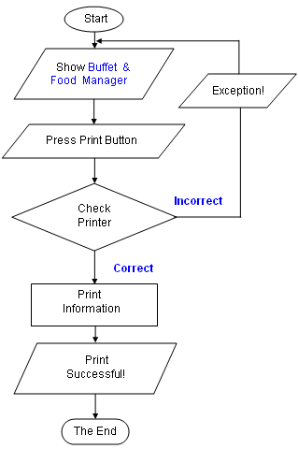
Print Food & Buffet Algorithms(Cont)
Delta Hotel

Slide 31
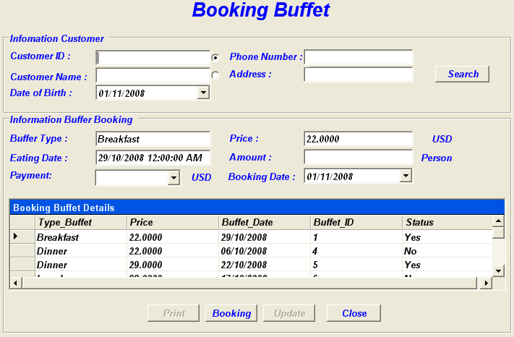
Form Booking Buffet
Delta Hotel

Slide 32
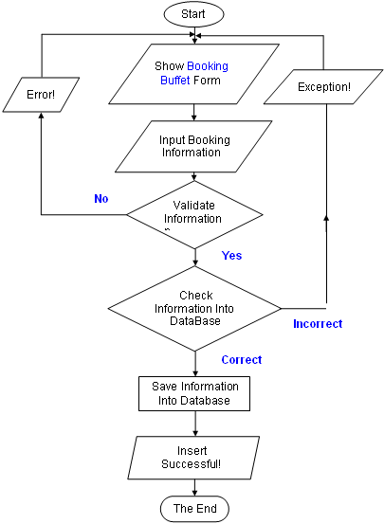
Booking Buffet Algorithm
Delta Hotel

Slide 33
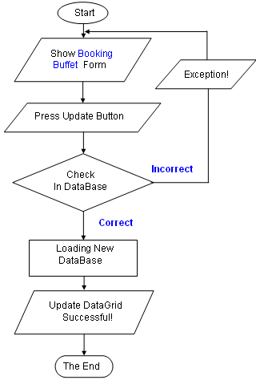
Update Booking Buffet Algorithm
Delta Hotel

Slide 34
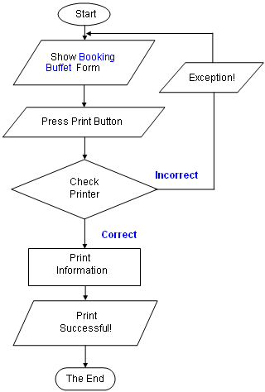
Print Booking Buffet Algorithm
Delta Hotel

Slide 35
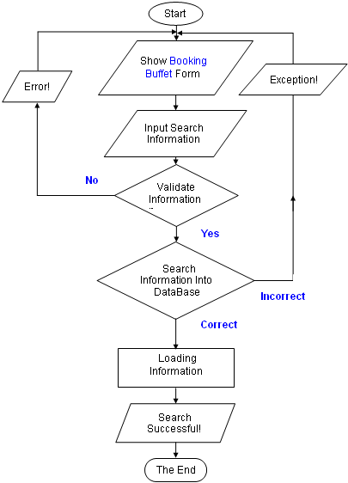
Search Booking Buffet Algorithm
Delta Hotel

Slide 36
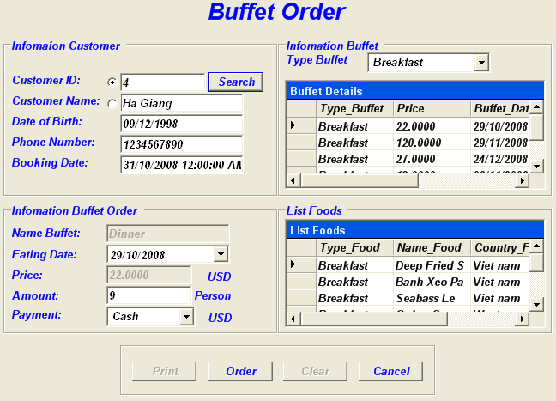
Form Buffet Order
Delta Hotel

Slide 37
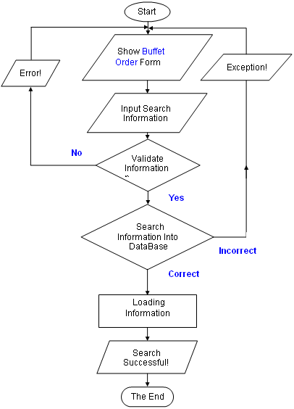
Search Buffet Order Algorithm
Delta Hotel

Slide 38
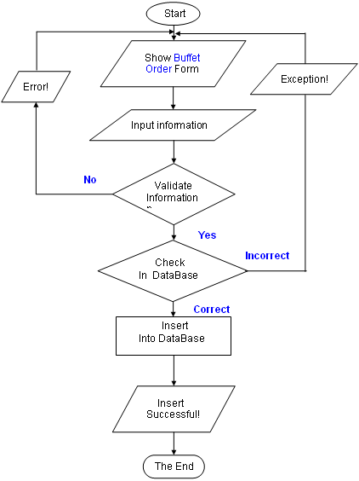
Buffet Order Algorithm
Delta Hotel

Slide 39
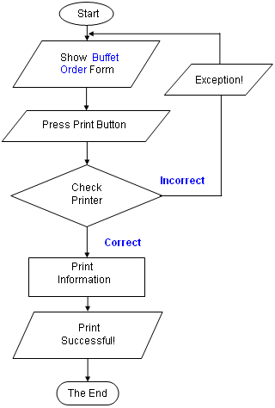
Print Buffet Order Algorithm
Delta Hotel

Slide 40
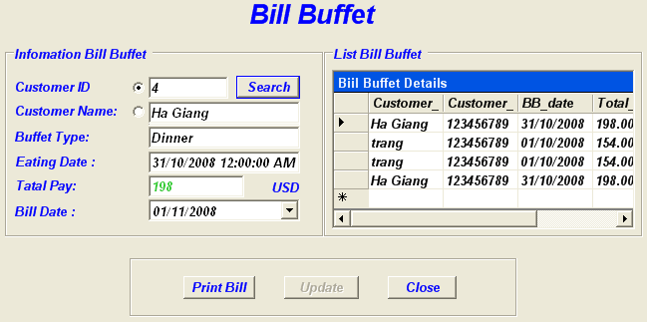
Form Bill Buffet
Delta Hotel

Slide 41
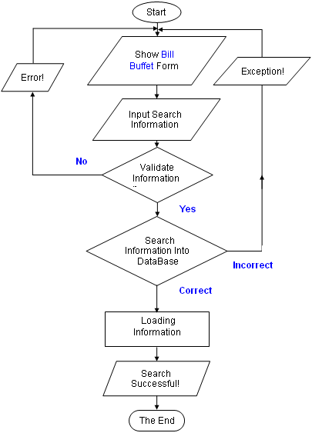
Search Bill Buffet Algorithm
Delta Hotel

Slide 42
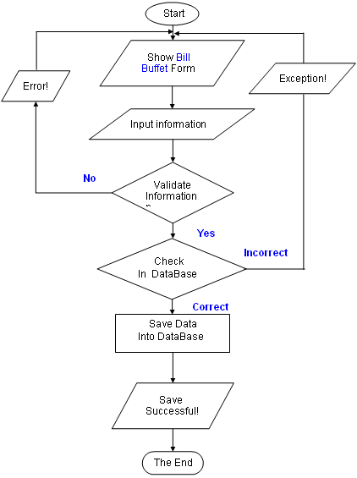
Save Bill Buffet Algorithm
Delta Hotel

Slide 43
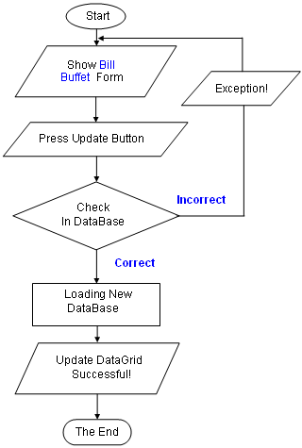
Update DataGrid Bill Buffet algorithm
Delta Hotel

Slide 44
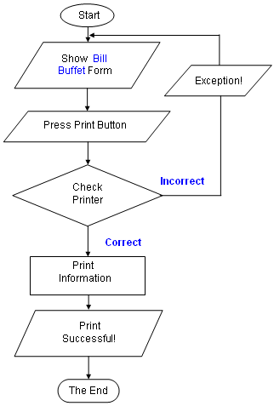
Print Bill Buffet Algorithm
Delta Hotel

Slide 45
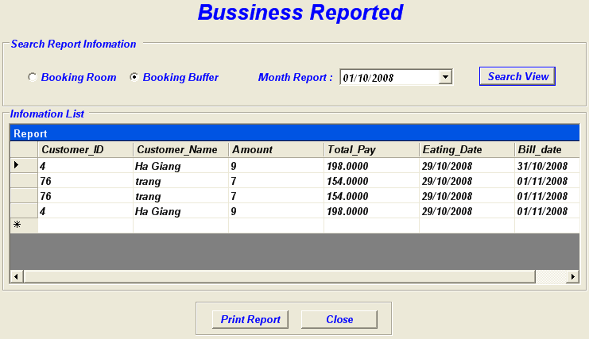
Form Bussiness Report
Delta Hotel

Slide 46
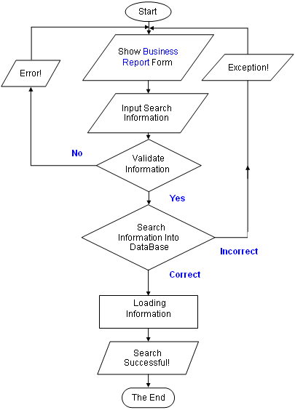
Search Business Report Algorithm
Delta Hotel

Slide 47
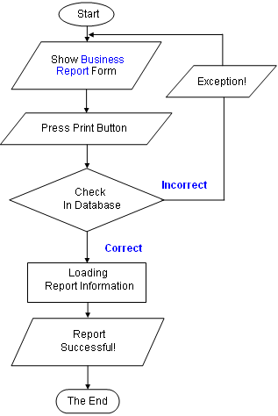
Print Business Report algorithm
Delta Hotel

Slide 48
Phan Thi Thuy Trang (CP200801-M06)
Delta Hotel
1
Project Plan
2
CheckOut Algorithm
3
3
Login Algorithmt
4
4
User manager Algorithmt
5
Add New Customer Algorithm
6
Bill Room Algorithm

Slide 49
Project Plan
Delta Hotel
Project Details:
  Name of the Client : DeltaHotel
  Release Date : 08-11-2008
  Project Vision/Objectives :
    Manage room, buffet,room booking ,buffet booking, customer,bill
    Scope:
  Functions:
  - Easy to use booking system, list buffet orders ,cancellation of orders,check bills.
  - Manager room.
  - Handle information and give out customer information.
  - Handle food, buffet and other services to customer.
  - Print food menu, bill, and report.

Slide 50
Project Plan(Cont)
Delta Hotel
  The process in the application have:
  - SearchRoom: Reception give the information of the room of the customer need and the application will show the searching result.
  - Manage Room: you can add new, modify room (with status of each room).
  - Manage Food: you can add new, modify or delete food type, food list.
  - Print bill when customer checkout and pay.
  - Print report.
  + For security, the application ask management their management’s account and password, and limit user roles.
  - Aministration: have full powers, can create and delete acount.
  - Reception or other employee: can do(insert, delete, and update): manage and search room, room type,chang password, room booking; add, search customer; order buffet, services; give out bill, accept payment

Slide 51
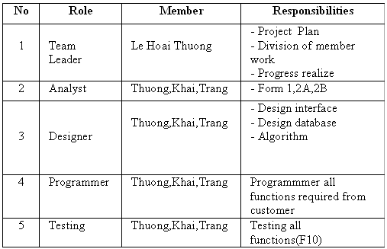
Project Plan(Cont)
Delta Hotel
Our understanding of the client organization.
  Catering services such as room, buffet …
  Receive the information from customers
  Process room booking and buffet booking
  Bill generation for customers
Project Organization with Responsibilities and Authorities :

Slide 52
Project Plan(Cont)
Delta Hotel
  2. Project initiation / Requirement Documents:
    The documents which Client apply to help his system manage information about :
    Room.
    Buffet.
    Check bill.
    Print report.
    Customer information.
  3. Deliverables:
    The documents to be handed over to the Client:
    - Designer Document
    - Installation Manual
    - User Manual
    - Maintenance Manual
    - Code documents

Slide 53
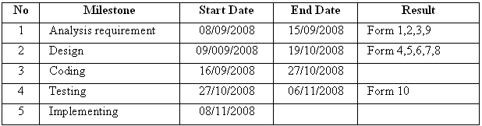
Project Plan(Cont)
Delta Hotel
4. Project Dependencies:
  Customer change requirement.
  More requests but do not give more time.
  System have some problems.
  Members in group disagree about database, and interface forms.
5. Major Project Milestones :

Slide 54
Project Plan(Cont)
Delta Hotel
6. Quality Plan :
  ◘ Review Activities (Review meeting participants, frequency)
  Meeting twice a week to discuss.
  ◘ Testing Activities (Final Test)
  Unit Testing
  Intergradations Testing
  Functional Testing
  User Testing
  ◘ Backup and recovery strategies (in case of disk crash, network failures)
  Data assurance , must be copy after each modifies .
  Data will be saved in DVD everyday.
  The newest of update .
  Anti virues.

Slide 55
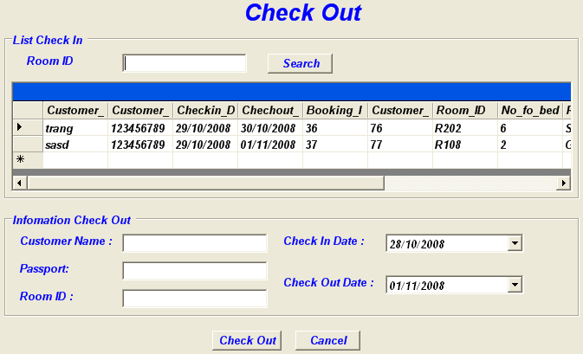
From check out
Delta Hotel

Slide 56
CheckOut Algorithm
Delta Hotel
Start
Display check out form
Choice customer
Check out
End

Slide 57
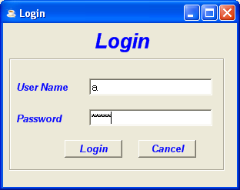
Login form
Delta Hotel

Slide 58
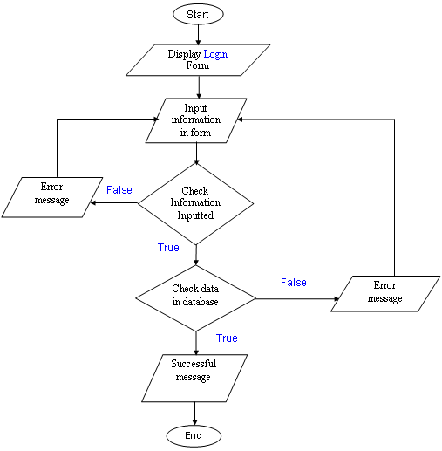
Login Algorithmt
Delta Hotel

Slide 59
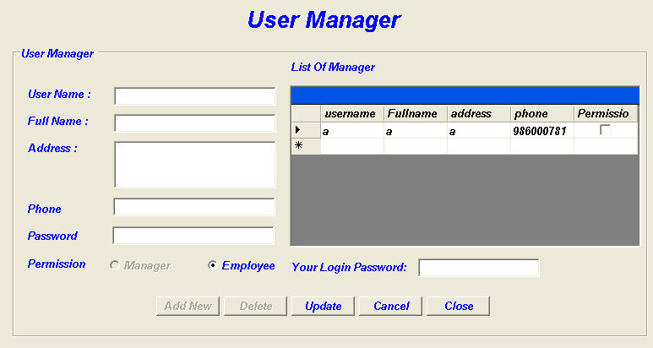
Form User manager
Delta Hotel

Slide 60
Add New Algorithmt
Delta Hotel
Begin
Display User Manager Form
Input information
Error Message
Check User name
False
True
Check Full name
False
True
Check address
False
True
False
Check phone
End
True
False
Add Information
Check password

Slide 61
Delete Algorithmt
Delta Hotel
Start
Display User Manager From
Select User to delete
Delete
End

Slide 62
Update Algorithm
Delta Hotel
Begin
Display User Manager From
Select User to update
Edit information of User
Check user name
False
Error Message
True
Check full name
False
True
False
Check address
True
False
End
Check phone
True
Update Information
Check password
False

Slide 63
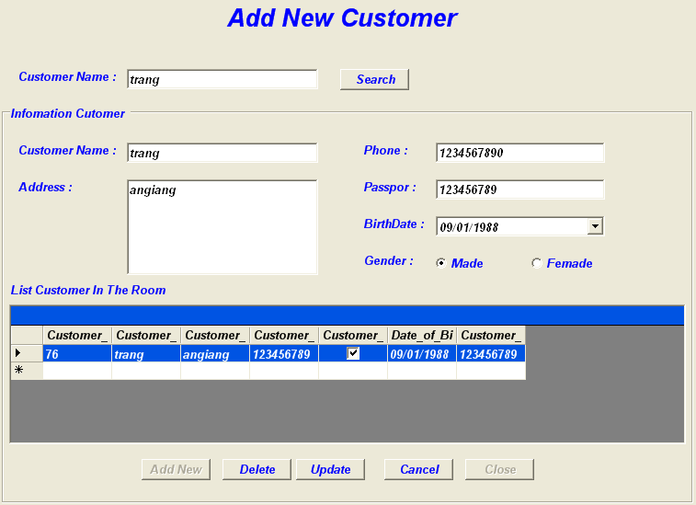
Form Add new Customer
Delta Hotel

Slide 64
Add New Customer Algorithm
Delta Hotel
Begin
Display Customer Form
Input information
Error Message
Check customer name
False
True
False
Check address
True
Check phone
False
True
Check passport
False
True
End
Add Information

Slide 65
Update Add New Customer Algorithm
Delta Hotel
Delta Hotel
Begin
Display Customer From
Select Customer to update
Edit information of Customer
Check customer name
False
Error Message
True
False
Check address
True
False
Check phone
True
Check passport
False
End
Update Information

Slide 66
Delete Algorithm
Delta Hotel
Begin
Display Customer From
Select Customer to delete
Delete
End

Slide 67
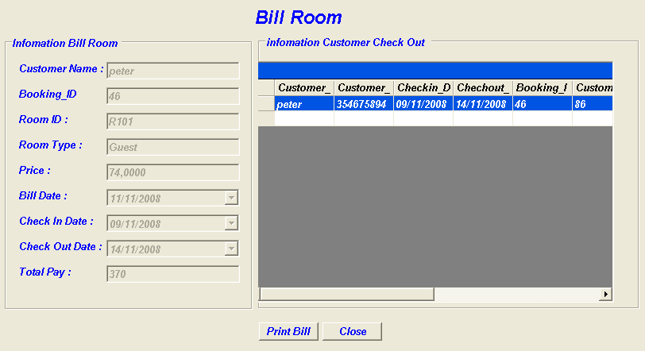
Bill Room Form
Delta Hotel
Start
Load customer information
Save information
Print Bill
End

Slide 68
Le Hoai Thuong (CP200701-F04)
Delta Hotel
Customer Requirements Spacifications
SEARCH ROOM Algoritmt
BOOKING ROOM Algorithmts
CHECK IN Algorithmts
Change Room Algorithmt
Task Sheet

Slide 69
Task Sheet
Delta Hotel
Project. No: | Project Title: | Activity plan prepared By: | Date of Preparation of Activity Plan:
TaskSup division | Description | Planned Start Date | Actual Start Date | Actual Date | Team Mate Names | Status
SWD/Form No.1 | Problems Definition document | 08/09/2008 | 12/09/2008 | 4 | Khai | Completed
SWD/Form No.2A | CRS Document | 08/09/2008 | 13/09/2008 | 5 | Thuong | Completed
SWD/Form No.2B | CRS Document | 13/09/2008 | 15/09/2008 | 2 | Trang | Completed
SWD/Form No.3 | Project Plan | 16/09/2008 | 17/09/2008 | 4 | Trang | Completed
SWD/Form No.4 | GUI Standards Document | 21/09/2008 | 25/09/2008 | 1 | Thuong | Completed
SWD/Form No.5 | Interface Design Document | 25/09/2008 | 26/09/2008 | 4 | Trang | Completed
SWD/Form No.6 | Table Design | 29/09/2008 | 30/09/2008 | 3 | Khai | Completed
Login Algorithm | Process Design Document | 08/10/2008 | 08/10/2008 | 6 | Trang | Completed

Slide 70
Task Sheet(cont)
Delta Hotel
UserManager Algorithm | Process Design Document | 08/10/2008 | 08/10/2008 | 6 | Trang | Completed
BillRoom Algorithm | Process Design Document | 09/10/2008 | 08/10/2008 | 5 | Trang | Completed
CheckOut Algorithm | Process Design Document | 09/10/2008 | 08/10/2008 | 5 | Trang | Completed
SearchRoom Algorithm | Process Design Document | 08/10/2008 | 08/10/2008 | 6 | Thuong | Completed
BookingRoom Algorithm | Process Design Document | 08/10/2008 | 08/10/2008 | 6 | Thuong | Completed
CheckIn Algorithm | Process Design Document | 09/10/2008 | 08/10/2008 | 5 | Thuong | Completed
Report Algorithm | Process Design Document | 09/10/2008 | 08/10/2008 | 5 | Khai | Completed
ChangeRoom Algorithm | Process Design Document | 09/10/2008 | 08/10/2008 | 5 | Thuong | Completed
MainForm Algorithm | Process Design Document | 08/10/2008 | 08/10/2008 | 6 | Thuong | Completed
BillBuffer Algorithm | Process Design Document | 09/10/2008 | 08/10/2008 | 5 | Khai | Completed
BufferOder Algorithm | Process Design Document | 08/10/2008 | 08/10/2008 | 6 | Khai | Completed

Slide 71
Task Sheet(cont)
Delta Hotel
BufferManager Algorithm | Process Design Document | 08/10/2008 | 08/10/2008 | 5 | Khai | Completed
BookingBuffer Algorithm | Process Design Document | 09/10/2008 | 08/10/2008 | 6 | Khai | Completed
Coding form Login | Design and Coding form Login | 15/10/2008 | 16/10/2008 | 1 | Trang | Completed
Coding form User Manager | Design and Coding User Manager | 15/10/2008 | 16/10/2008 | 2 | Trang | Completed
Coding form Bill Room | Design and Coding Bill Room | 15/10/2008 | 16/10/2008 | 3 | Trang | Completed
Coding form Check Out | Design and Coding Check Out | 15/10/2008 | 16/10/2008 | 3 | Trang | Completed
Coding form Customer | Design and Coding Customer | 15/10/2008 | 16/10/2008 | 3 | Trang | Completed
Coding form Search Room | Design and Coding Search Room | 15/10/2008 | 16/10/2008 | 2 | Thuong | Completed
Coding form Booking Room | Design and Coding Booking Room | 15/10/2008 | 16/10/2008 | 2 | Thuong | Completed

Slide 72
Task Sheet(cont)
Delta Hotel
Coding form Check In | Design and Coding Check In | 15/10/2008 | 16/10/2008 | 2 | Thuong | Completed
Change Room | Design and Coding Change Room | 15/10/2008 | 16/10/2008 | 3 | Thuong | Completed
Coding form Report | Design and Coding Report Room | 15/10/2008 | 16/10/2008 | 2 | Khai | Completed
Coding form Main Form | Design and Coding Main Form | 15/10/2008 | 16/10/2008 | 1 | Thuong | Completed
Coding form Bill Buffer | Design and Coding Bill Buffer | 15/10/2008 | 16/10/2008 | 2 | Khai | Completed
Coding form Buffer Order | Design and Coding Buffer Oder | 15/10/2008 | 16/10/2008 | 2 | Khai | Completed
Coding form Buffer Manager | Design and Coding Buffer Manager | 15/10/2008 | 16/10/2008 | 2 | Khai | Completed
Coding form Booking Buffer | Design and Coding Booking Buffer | 15/10/2008 | 16/10/2008 | 2 | Khai | Completed

Slide 73
Task Sheet(cont)
Delta Hotel
Test form Login | Test valid form Login date | 27/10/2008 | 28/10/2008 | 1 | Group IV | Completed
Test form User Manager Room | Test valid form User Manager date | 27/10/2008 | 28/10/2008 | 1 | Group IV | Completed
Test form Bill Room | Test valid form Bill Room date | 27/10/2008 | 28/10/2008 | 1 | Group IV | Completed
Test form Check Out Room | Test valid form Check Out Room date | 27/10/2008 | 28/10/2008 | 1 | Group IV | Completed
Test form Search Room | Test valid form Check Out Room date | 27/10/2008 | 28/10/2008 | 1 | Group IV | Completed
Test form Booking Room | Test valid form Booking Room date | 27/10/2008 | 28/10/2008 | 1 | Group IV | Completed
Test form Check In Room | Test valid form Check In Room date | 27/10/2008 | 28/10/2008 | 1 | Group IV | Completed
Test form Change Room | Test valid form Change Room date | 27/10/2008 | 28/10/2008 | 1 | Group IV | Completed
Test form Report Room | Test valid form Report Room date | 27/10/2008 | 28/10/2008 | 1 | Group IV | Completed

Slide 74
Task Sheet(cont)
Delta Hotel
Test form Bill Buffer | Test valid form Bill buffer date | 27/10/2008 | 28/10/2008 | 1 | Group IV | Completed
Test form Buffer Oder | Test valid Buffer Oder date | 27/10/2008 | 28/10/2008 | 1 | Group IV | Completed
Test form Booking Buffer | Test valid form Booking Buffer date | 27/10/2008 | 28/10/2008 | 1 | Group IV | Completed
Test form Buffer Manager | Test valid form Buffer Manager date | 27/10/2008 | 28/10/2008 | 1 | Group IV | Completed
Test form Main Form | Test valid form Main Form date | 27/10/2008 | 28/10/2008 | 1 | Group IV | Completed
SWD/Form No.11 | Project review | 27/10/2008 | 28/10/2008 | 1 | Group IV | Completed
SWD/Form No.12 | Final Check List | 28/10/2008 | 29/10/2008 | 1 | Group IV | Completed
Test Software | Test all Software | 30/10/2008 | 31/10/2008 | 1 | Group VI | Completed
Implement Software | Reviewed all Implement Software | 02/11/2008 | 04/11/2008 | 2 | Group VI | Completed

Slide 75
Customer Requirements Spacifications
Delta Hotel
Clien/Project Undertaken: DeltaHotel
  List of input to the system:
    Information of the room.
    Information of the catering services.
    Information of the customer.
    Booking information.
  List of outputs expected from the system:
    List item of room.
    Search Room.
    Report for manager.
    Bill Room .
    Bill Buffet .
    List item of customer .

Slide 76
Customer Requirements Spacifications(Cont)
Delta Hotel
  Overview of processes involved in the system:
    Room Booking process in step by step (fast and friendly)
    Order buffets process in step by step (fast and friendly)
    Check if the input of the system is valid.
    Calculate payment, print bill, and report and print report.
    Add ,delete the imformation about Food and Buffet.
    Add, delete, update the information about customers, room, services, ...
    Change User name and Password.
Hardware and software required for implementing the project:
  Client side:
    Software: OS: Windows 2000 or later, .NET Framework 1.1 or later.
    Hardware: About 400 USD or higher.
  Server side:
    Software: OS: Windows Server 2003 or later, SQL Server 2000 or higher.
    Hardware: About 800 USD or higher.

Slide 77
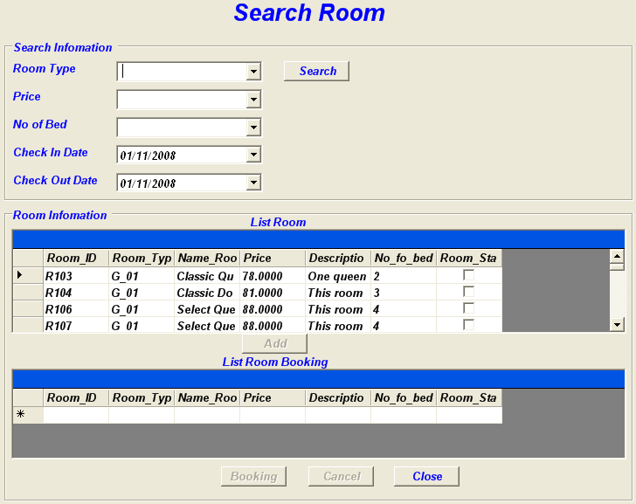
Form Search Room
Delta Hotel

Slide 78
SEARCH ROOM Algoritmt
Delta Hotel
Begin
Display form Search Room on screen
Select information need to Search
Access to database
Test database
N
Message no found
Y
Display All Rooms available
Select one Rooms available
End
Click button Add
Message complete
Select Room in datagrid process
Click button Booking

Slide 79
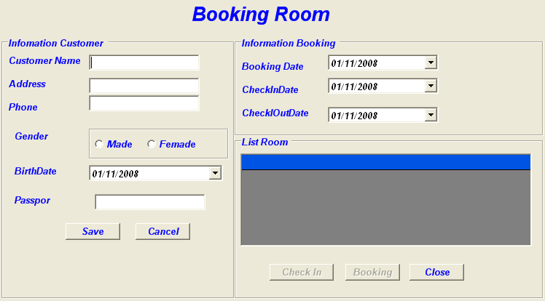
Form Booking Room
Delta Hotel

Slide 80
BOOKING ROOM Algorithmts
Delta Hotel
Begin
Display form Booking Room on screen
Input information Customer in form
Test Valid
N
Message error
Y
Save on database
Successful
N
Message error
Y
Choice Room in Datagrid needs Book
Click button Booking
Message complete
End

Slide 81
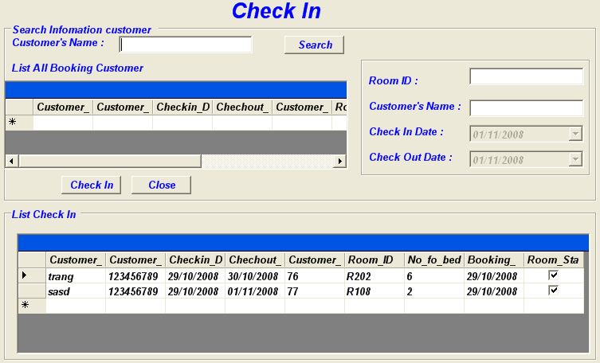
Form Check in Room
Delta Hotel

Slide 82
CHECK IN Algorithmts
Delta Hotel
Begin
Display form Booking Room on screen
Input information in form needs Check In
Test Valid
N
Message error
Y
Save on database
Successful
N
Message error
Y
Choice Room in Datagrid Check In
Click button Check In
Message successful
End

Slide 83
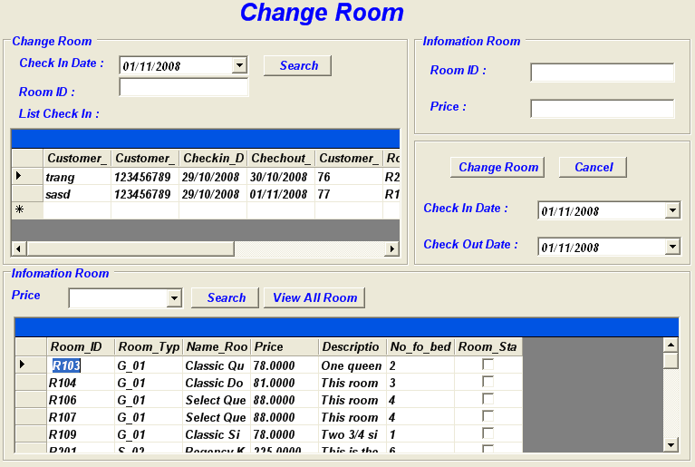
From Change Room
Delta Hotel

Slide 84
Change Room Algorithmt
Delta Hotel
Begin
Display form Booking Room on screen
Input information in form needs Check In
Test Valid
N
Message error
Y
Save on database
Successful
N
Message error
Y
Choice Room in Datagrid Check In
Click button Check In
Message successful
End

Slide 85
Thank You !
www.DeltaHotel.com
Delta Hotel

